Slide 1
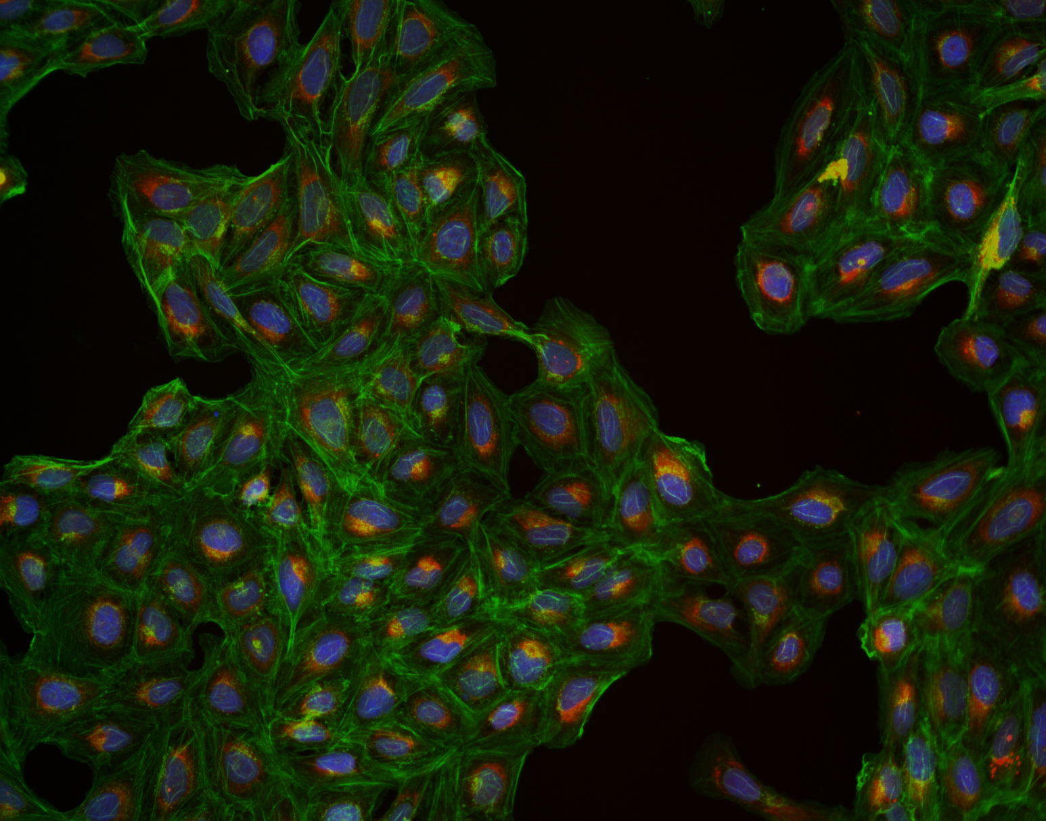



Slide 2
Single cell morphological analysis
Benjamin Frey
Supervision:
Ola Spjuth, Jordi Carreras-Puigvert and David Holmberg
Special mention:
Dan Rosén

Slide 3
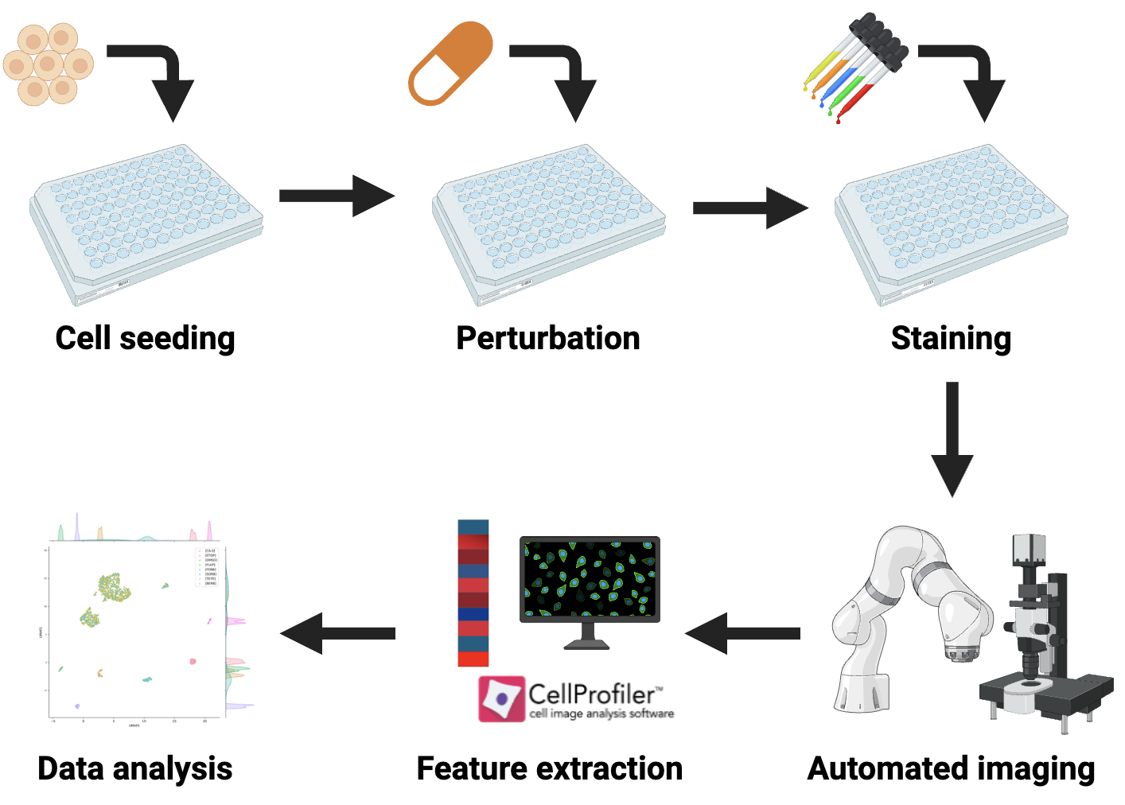
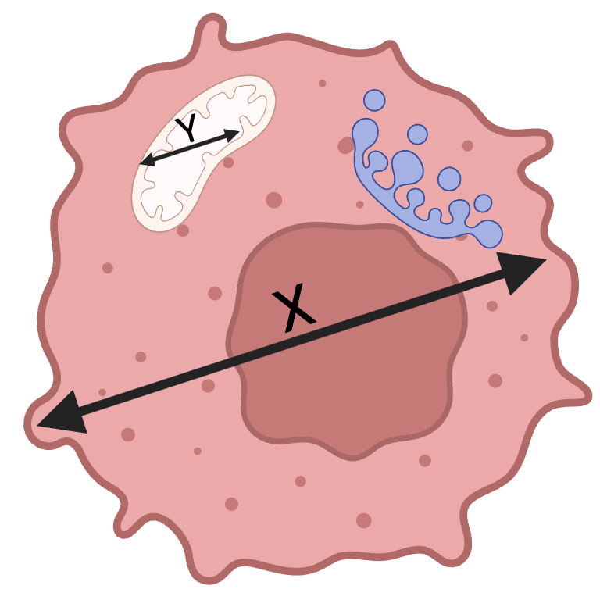
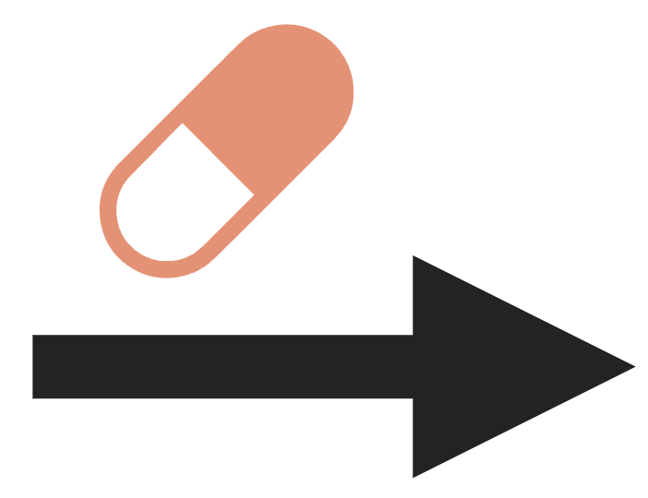
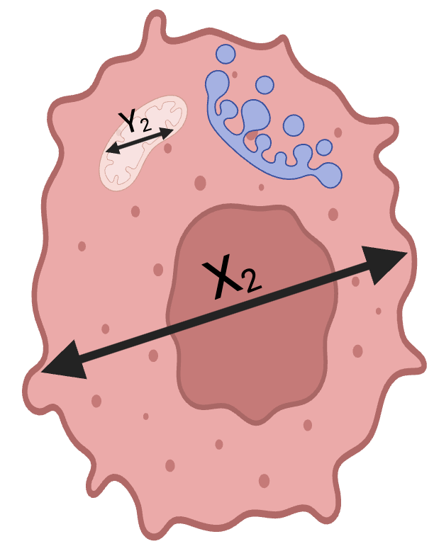
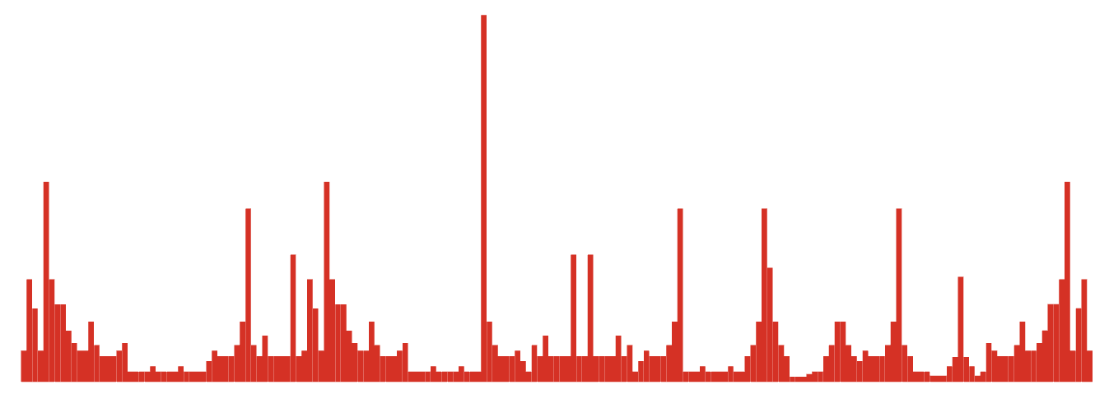
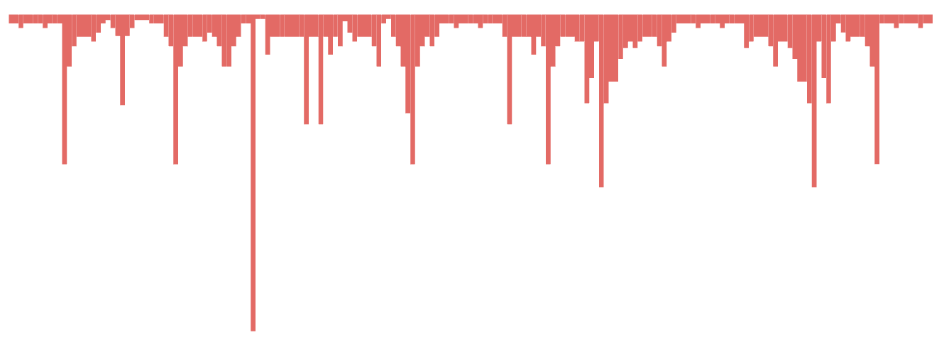
Cell painting enables unbiased phenotypical screening
Morphological profile 1
Morphological profile 2

Slide 4
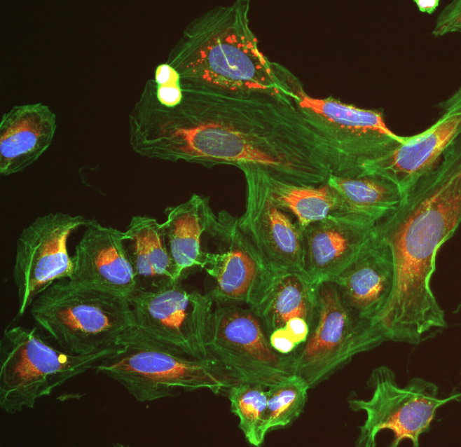
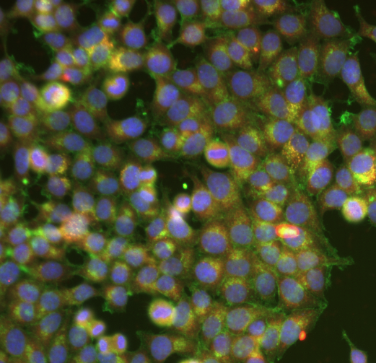
Datasets
SPECS5K
Cell death experiment
> 5000 compounds, fixed doses
86 plates
> 20,000,000 cells
U2OS (Osteosarcoma)
> 1,000 MoA classes
74 compounds, six doses
8 plates
> 10,000,000 cells
MCF7 (Adenocarcinoma)
8 MoA classes

Slide 5

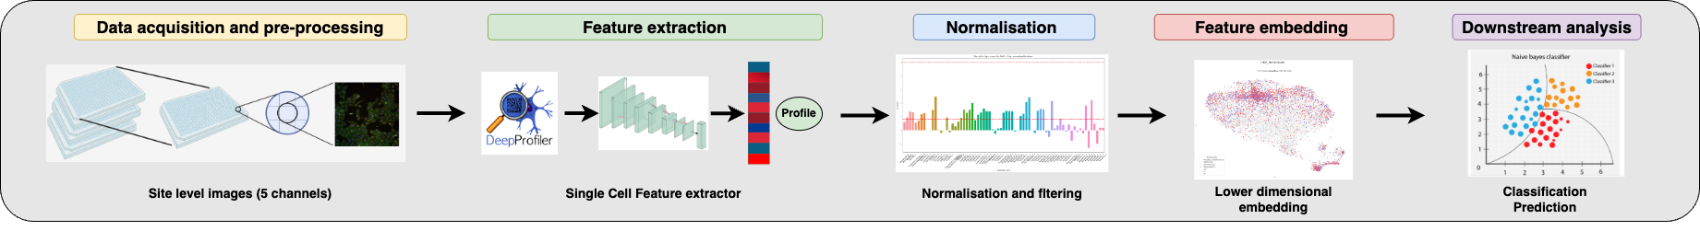
Workflow

Slide 6
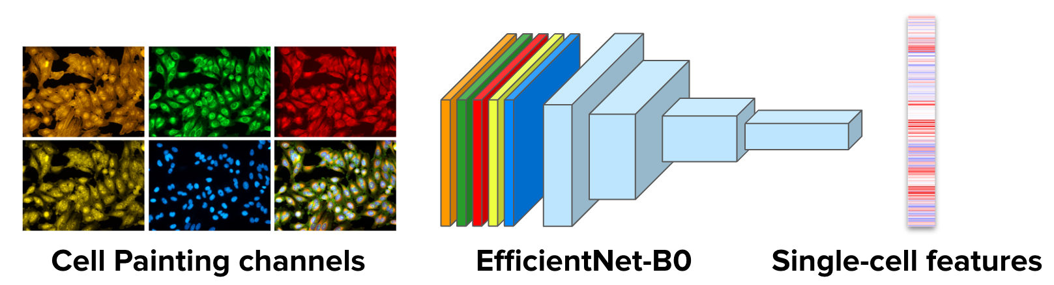
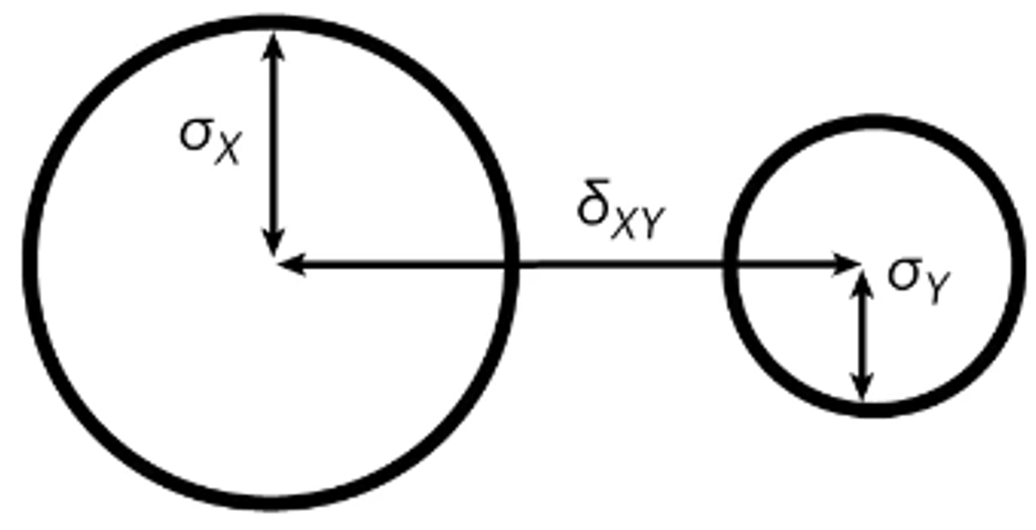
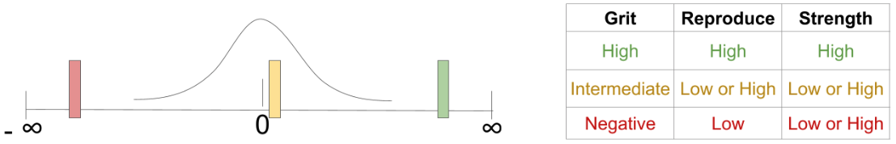
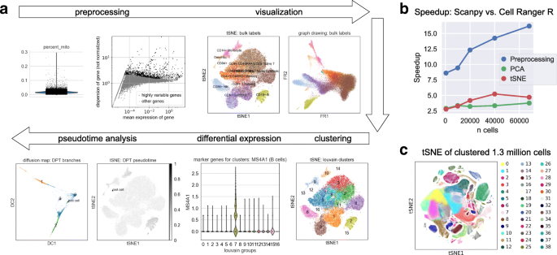
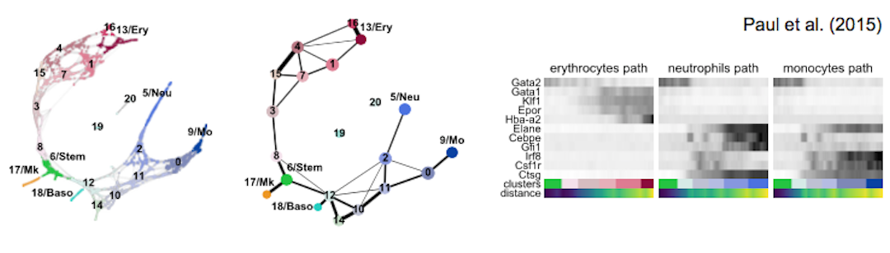

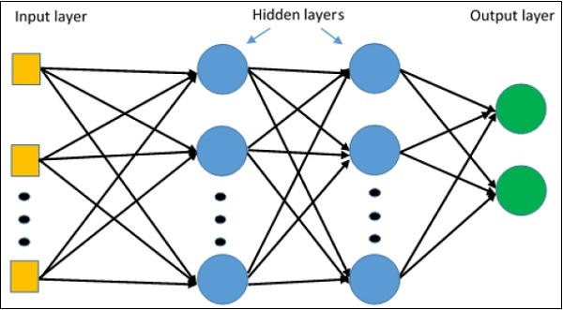
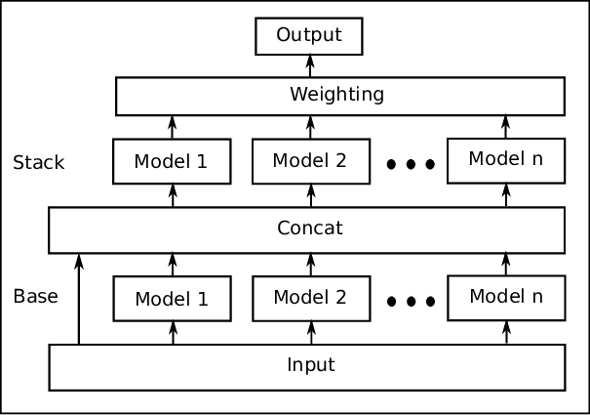
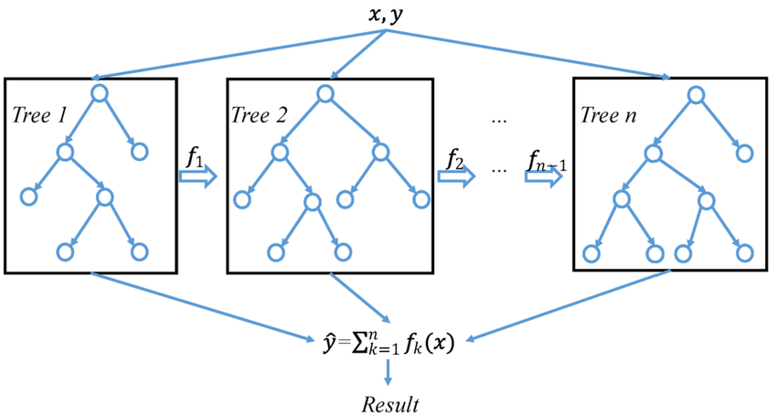
Selected methods
DeepProfiler
Block6a_activation
Grit score & e distance
Scanpy
MLP & AutoML

Slide 7
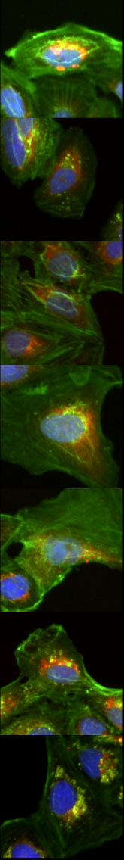
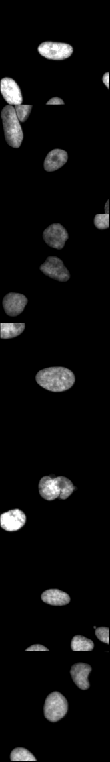
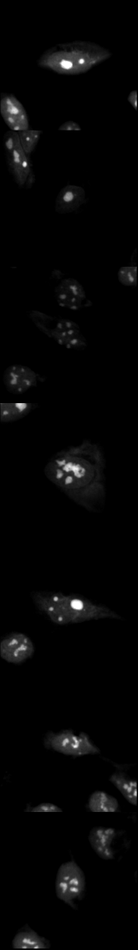
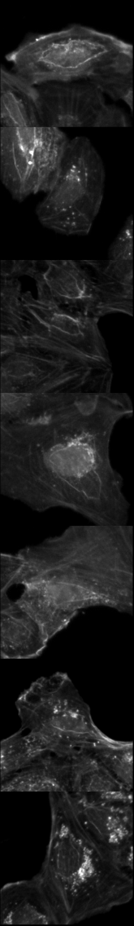
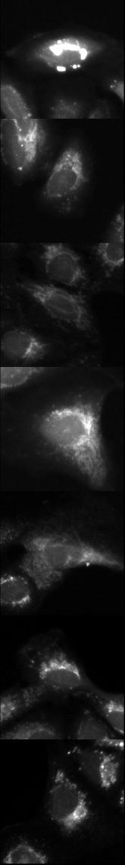
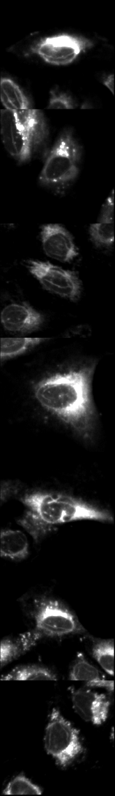
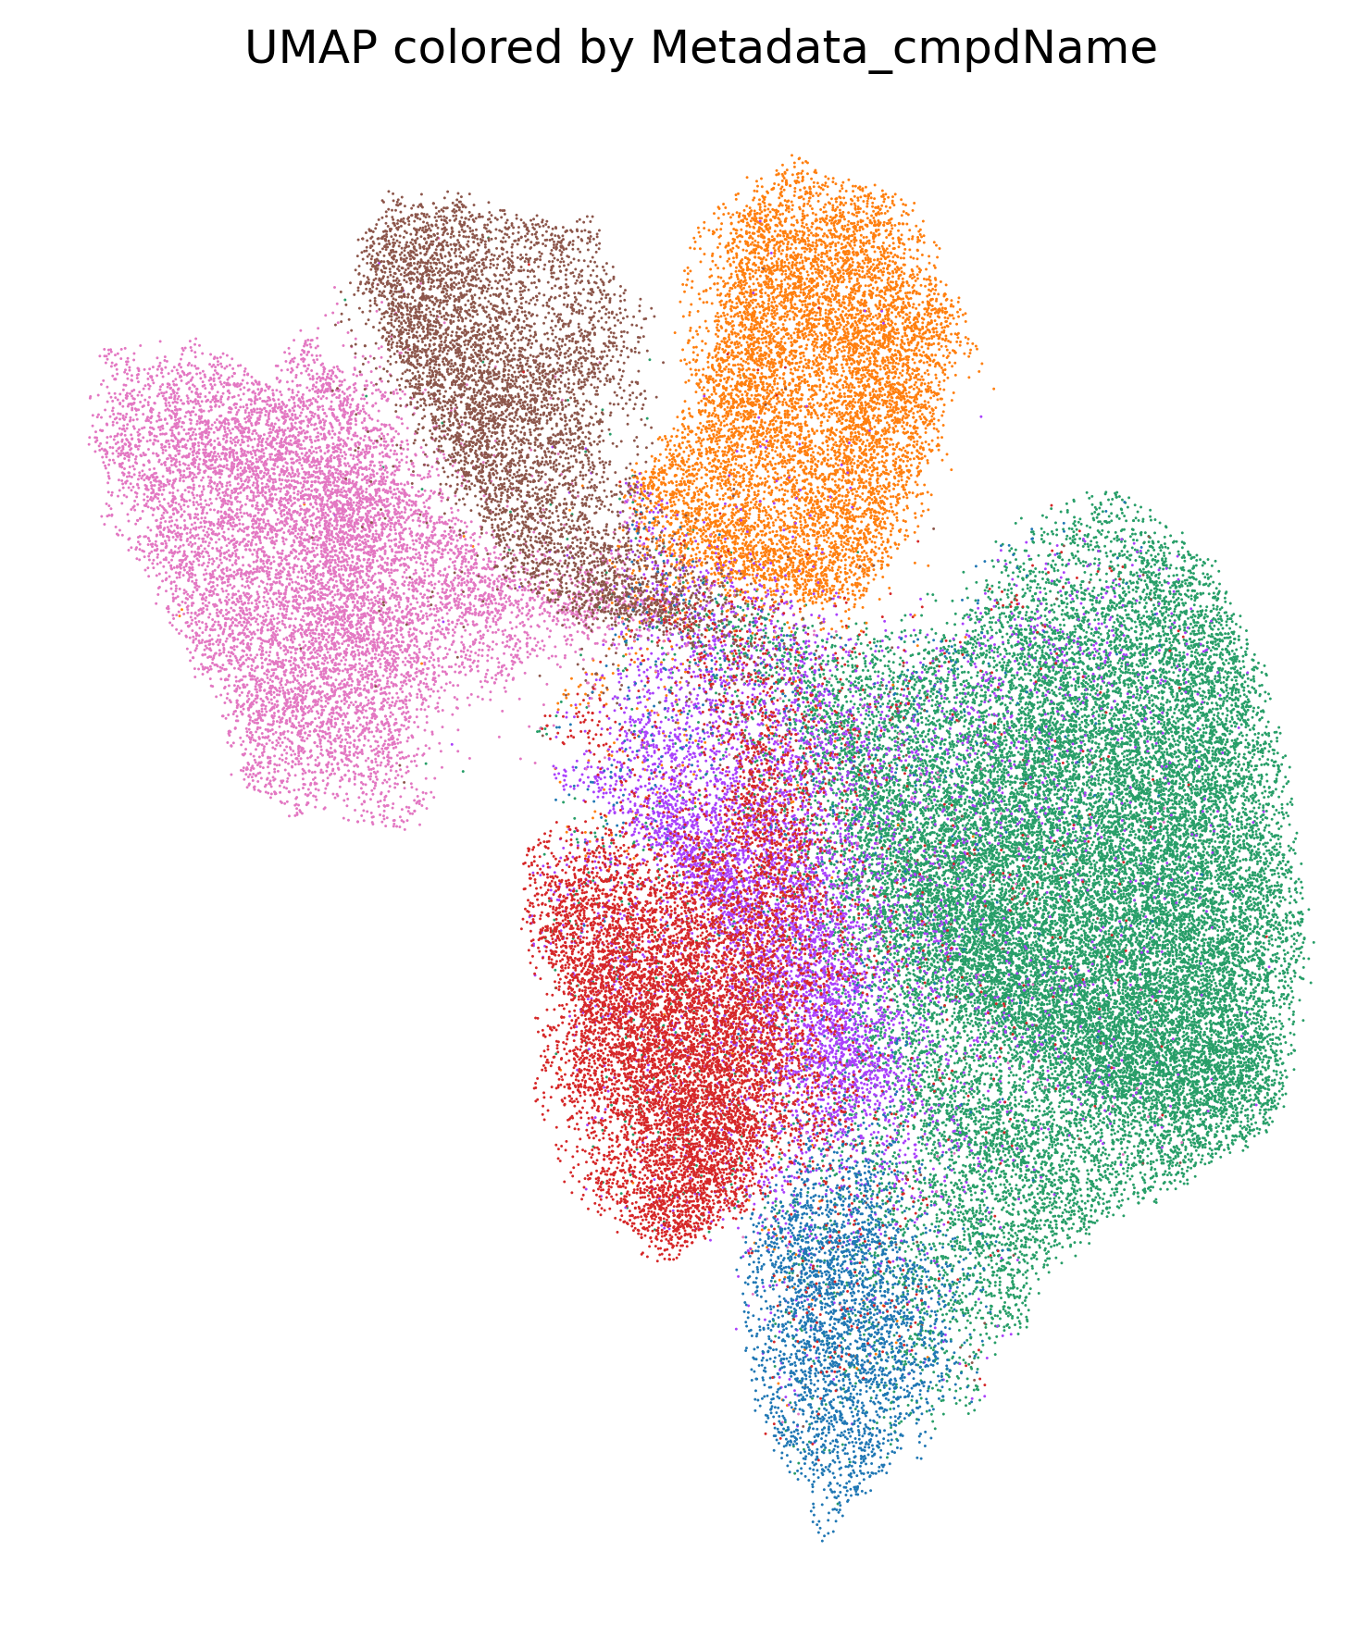
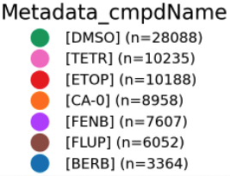
SPECS reference compounds show distinct morphologies
HPM
DNA
RNA
AGP
Mito
ER
E dist
1613
1104
0
545
712
720
1278
Berb
CA-O
DMSO
k-medoid
Etop
Fenb
UMAP 2
Flup
UMAP 1
Tetr

Slide 8
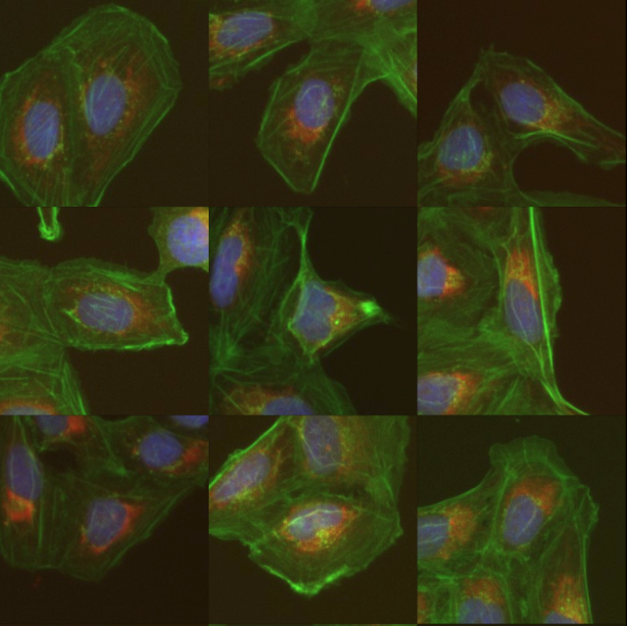
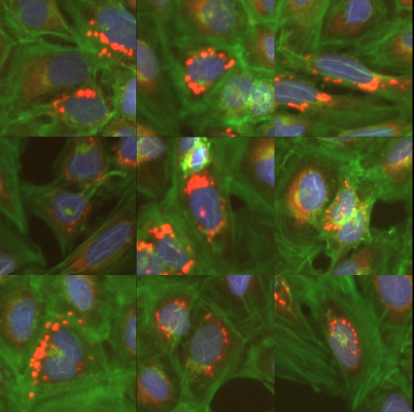
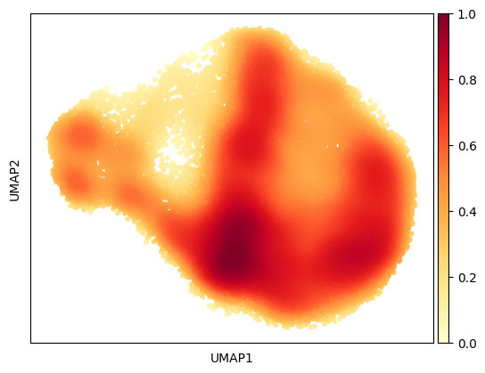
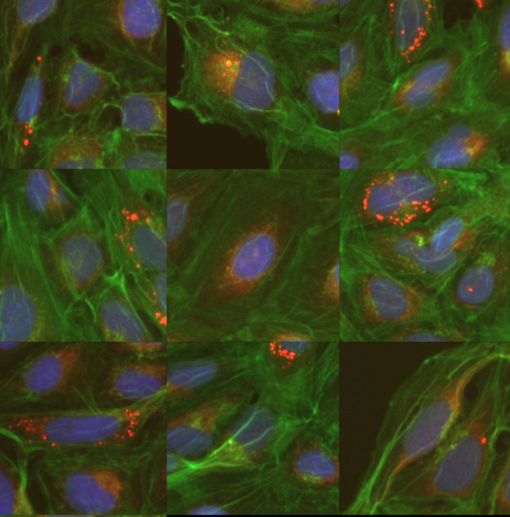
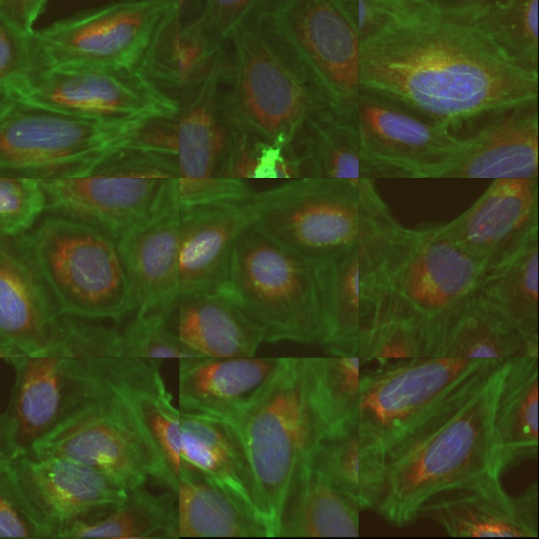
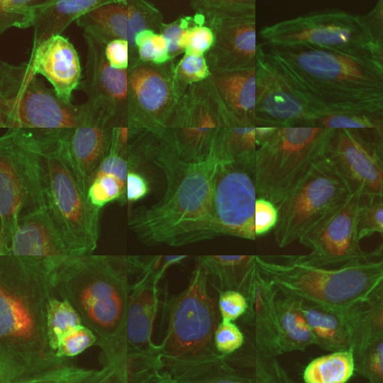
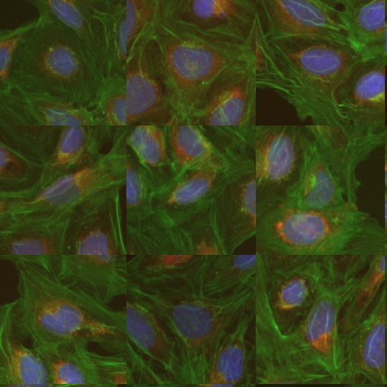
DMSO density regions can reveal subpopulations

Slide 9
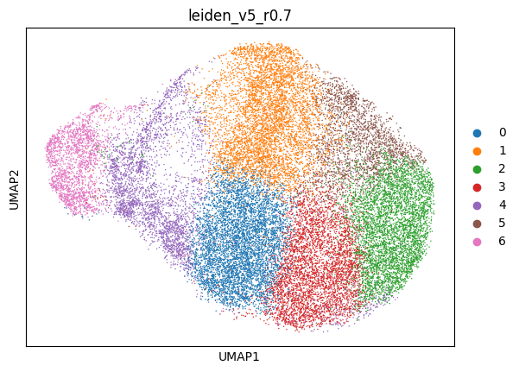
DMSO density regions can reveal subpopulations
Loose cell populations
High mitochondrial signal
Metabolically active?
High AGP signal
High nucleus signal
Dying/ dividing cells?
Dense cell populations
“Core population”?

Slide 10
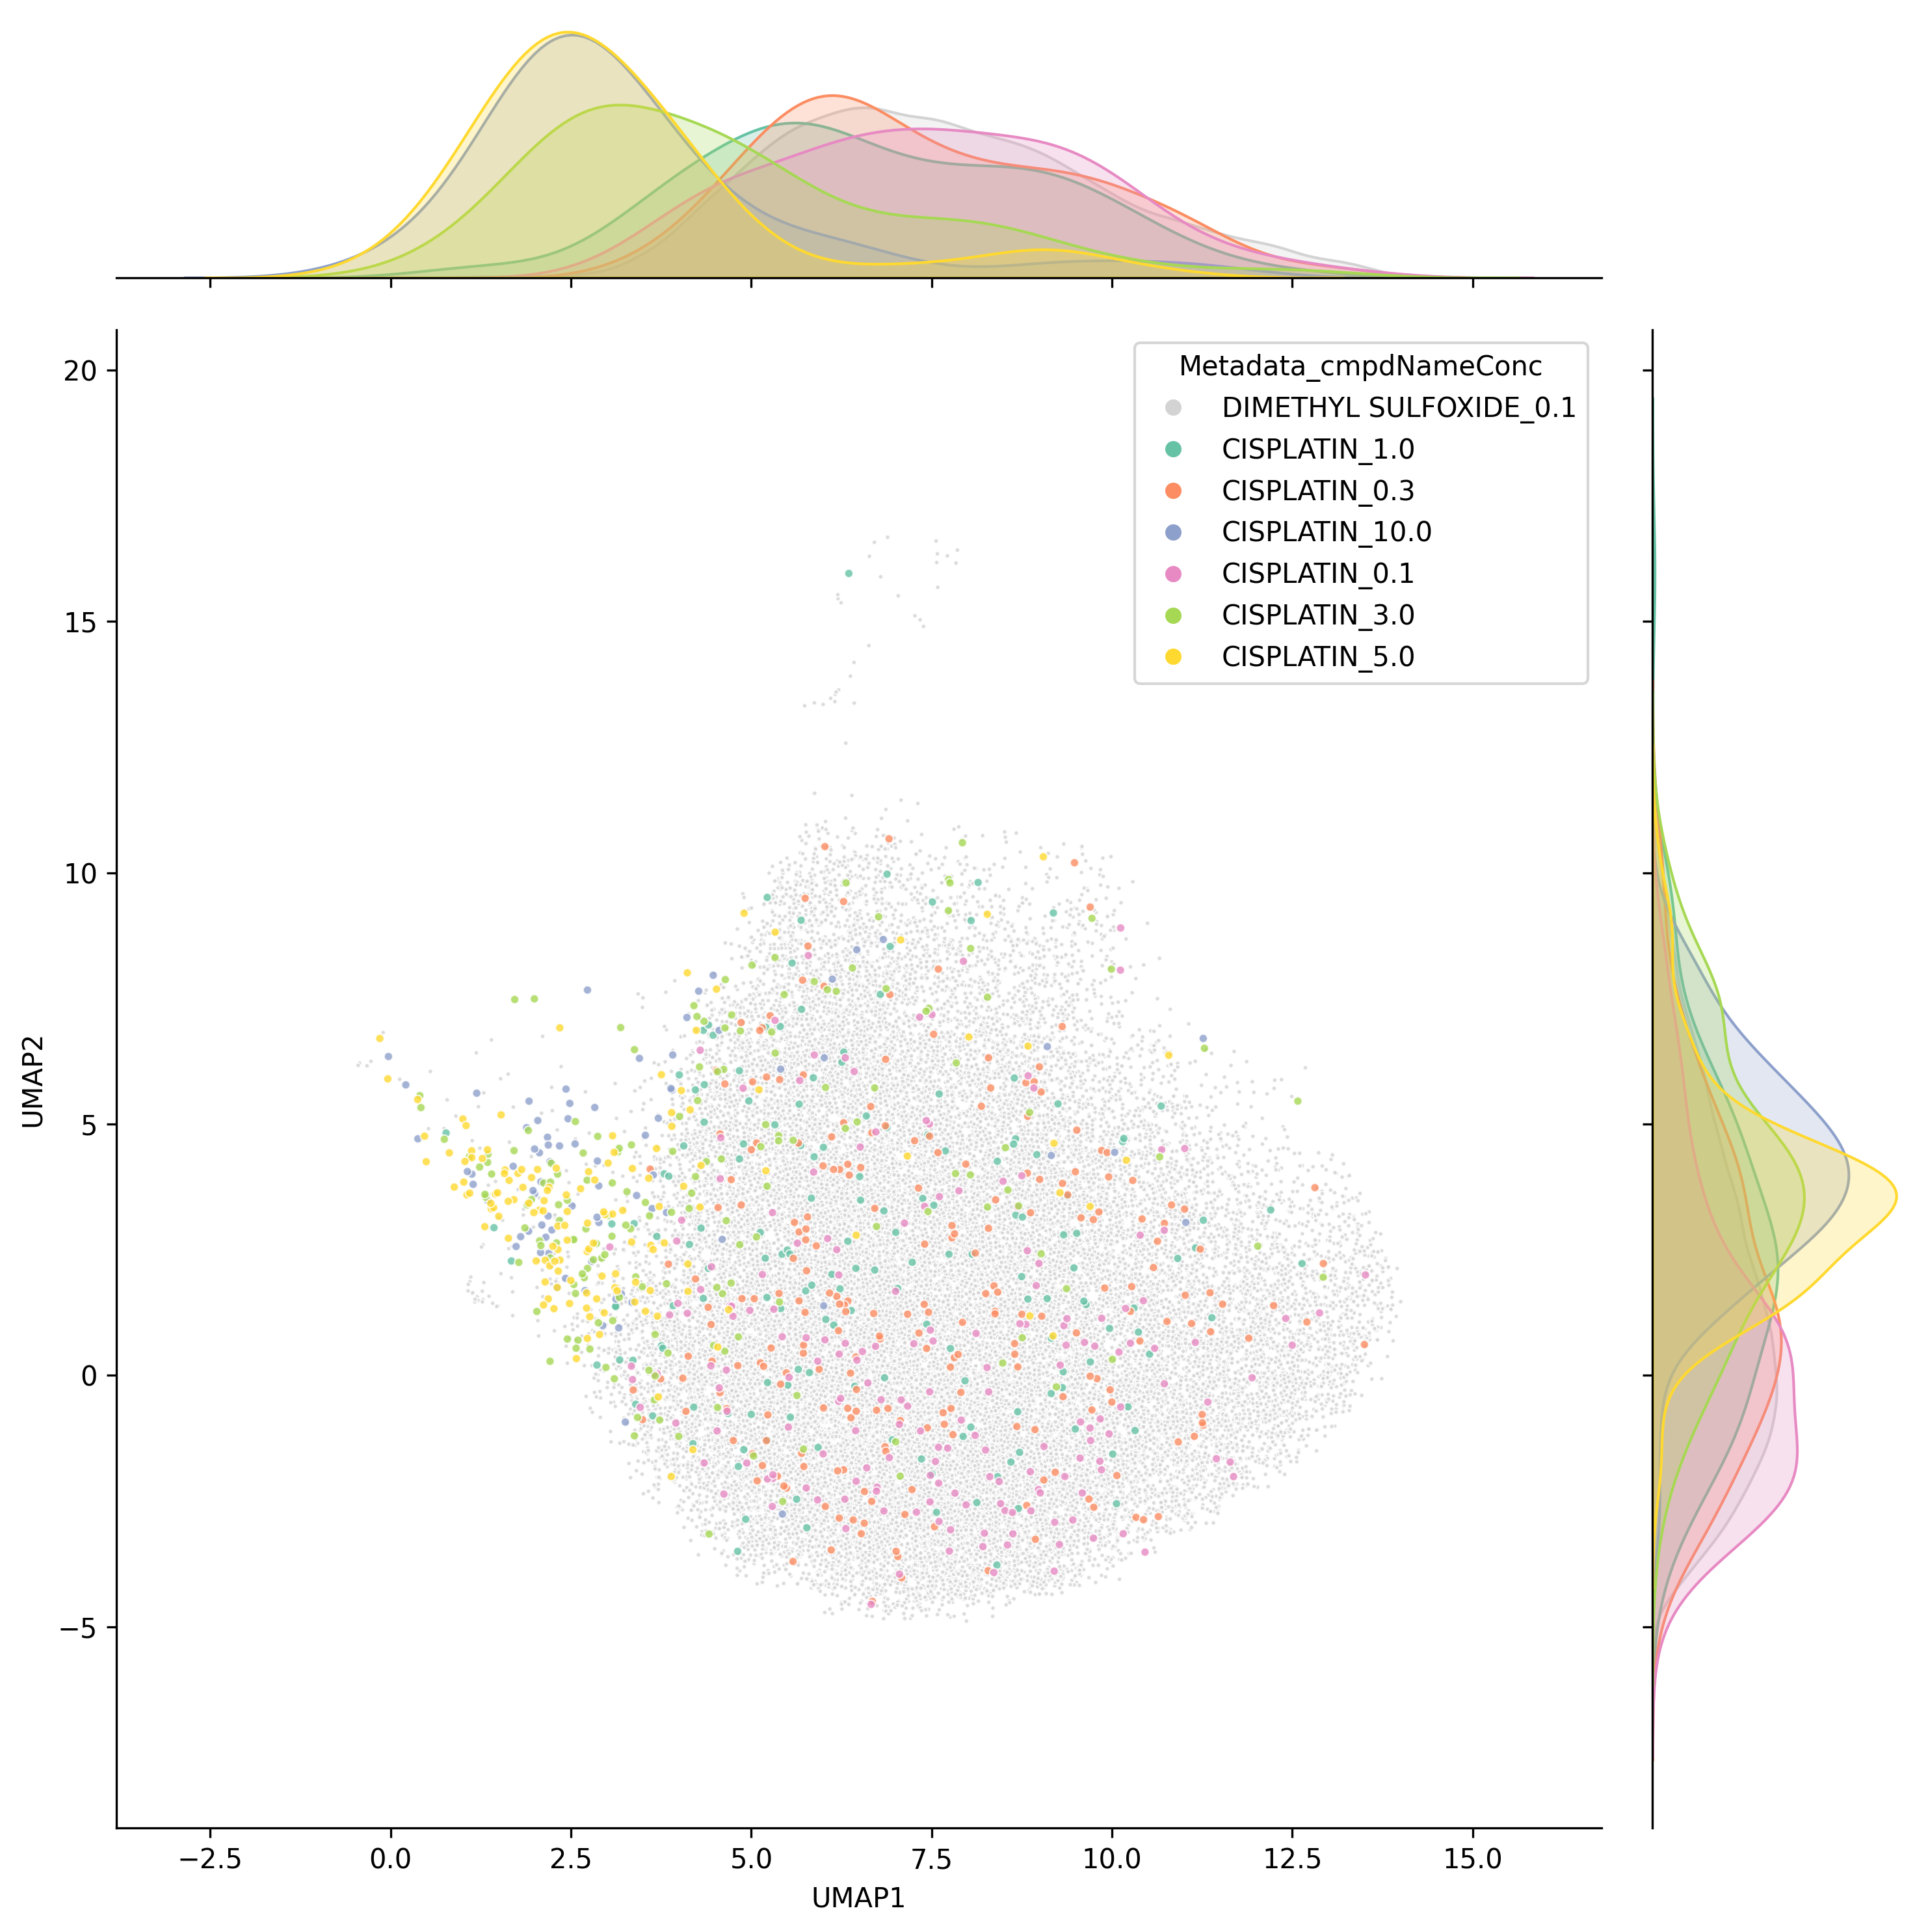
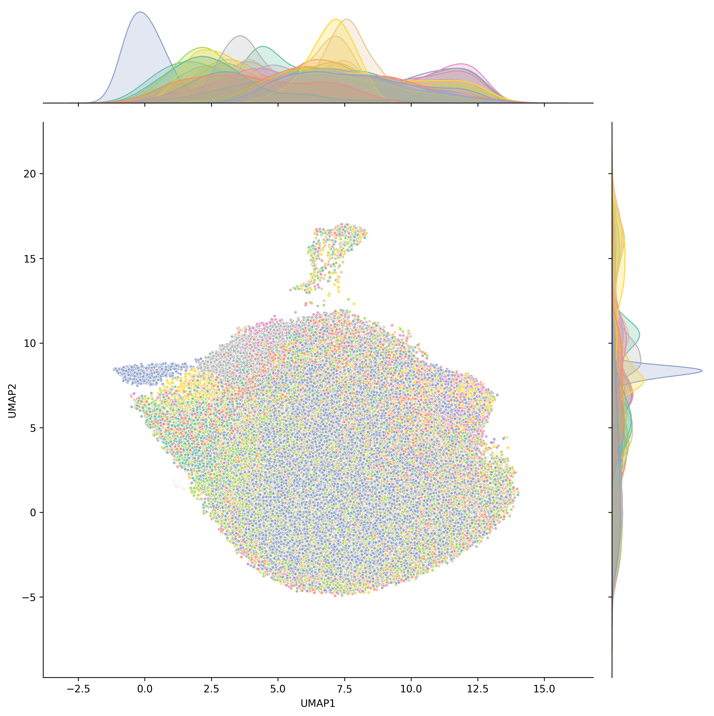
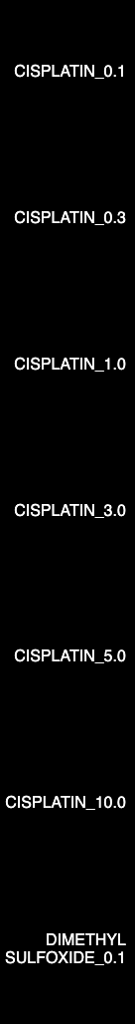
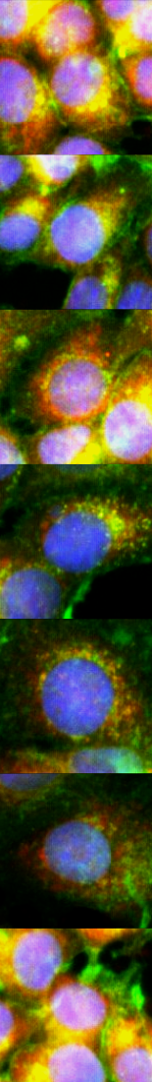
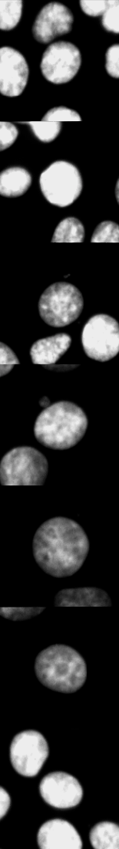
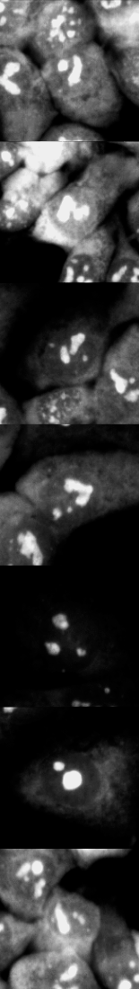
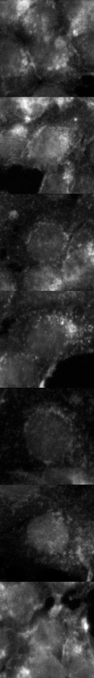
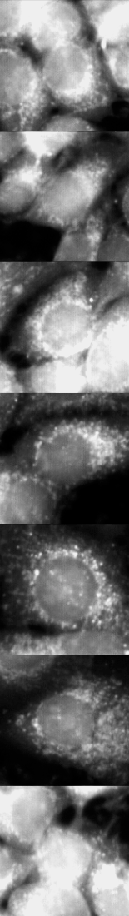
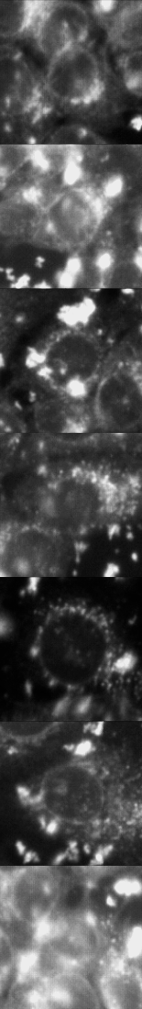
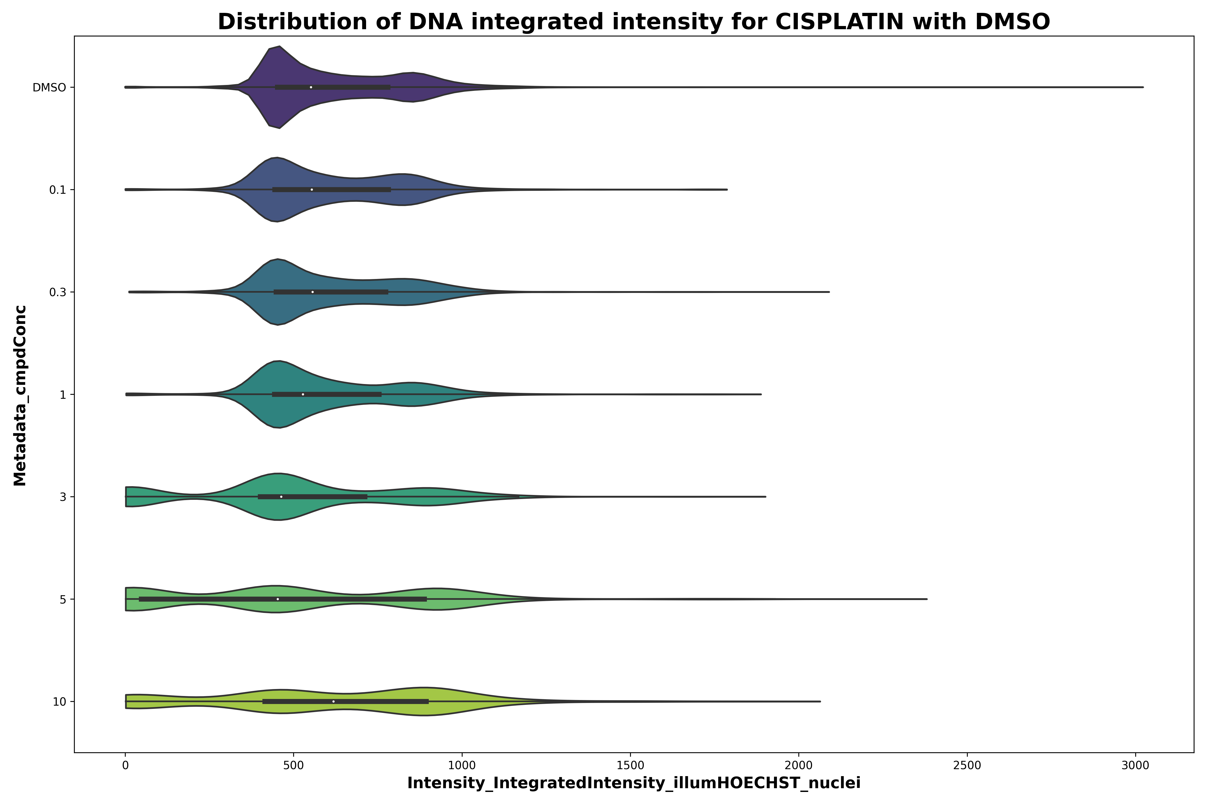
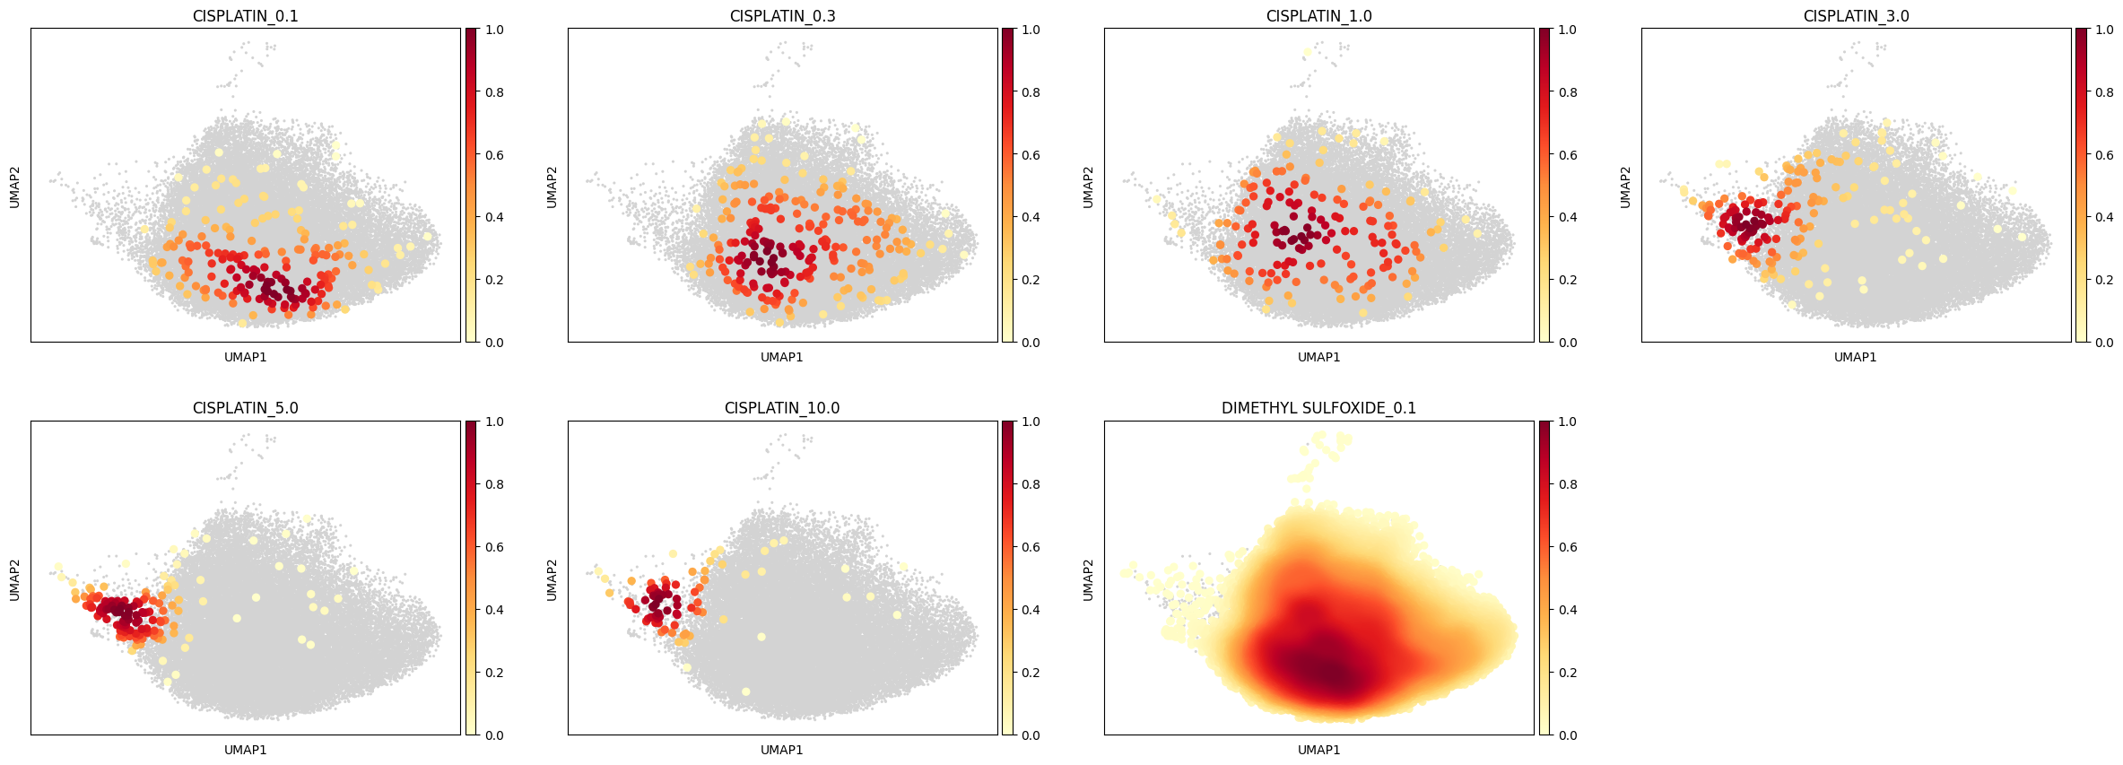

Cell death experiment data provides insight into dose dependant morphologies
HPM
DNA
RNA
AGP
Mito
ER
Full single cell compound embedding
Cisplatin + DMSO embedding

Slide 11
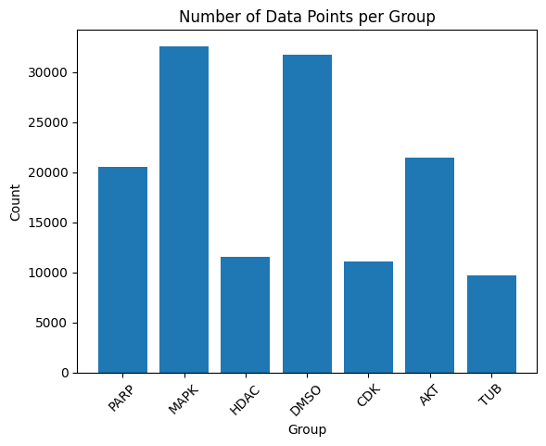
Mechanism of Action prediction in SPECS5K
6 + DMSO MoA classes
11 (12 CDK) compounds per MoA
Single cell feature vectors
Total of ~140,000 cells

Slide 12
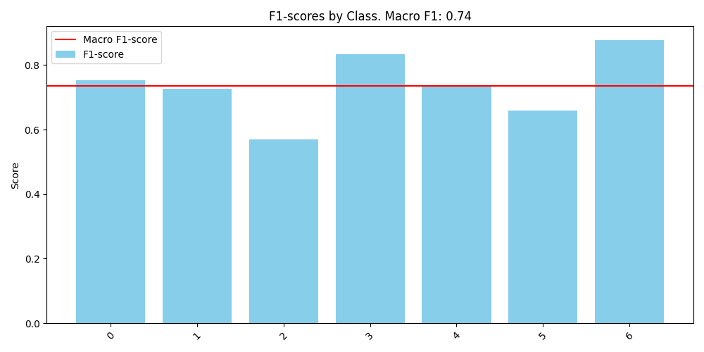


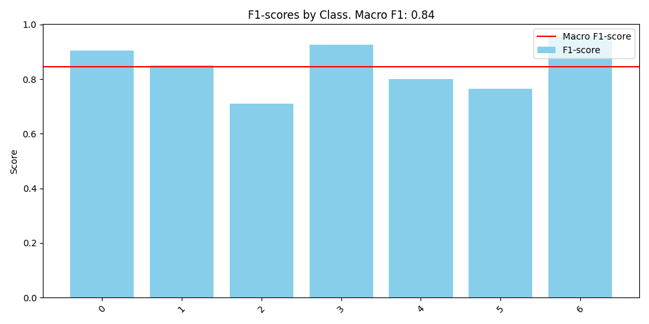
MLP and ensemble methods for MoA prediction
MLP
Tabular single-cell features
AutoGluon ensemble

Slide 13
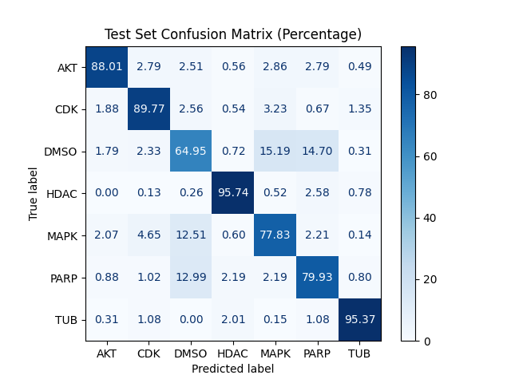
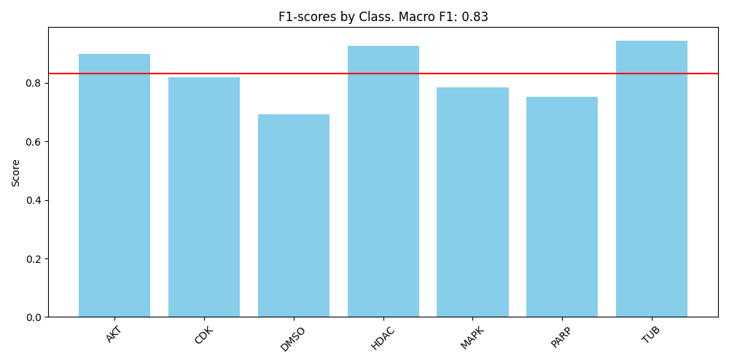
MLP predicts MoAs mostly accurately

Slide 14
MLP and ensemble methods for MoA prediction
MLP
Tabular single-cell features
AutoGluon ensemble

Slide 15


AutoGluon ensemble beats other classifiers
AutoGluon top model

Slide 16
Thank You!

Slide 17
Selected references
Caicedo JC, Cooper S, Heigwer F, Warchal S, Qiu P, Molnar C, Vasilevich AS, Barry JD, Bansal HS, Kraus O, Wawer M, Paavolainen L, Herrmann MD, Rohban M, Hung J, Hennig H, Concannon J, Smith I, Clemons PA, Singh S, Rees P, Horvath P, Linington RG, Carpenter AE. 2017. Data-analysis strategies for image-based cell profiling. Nature Methods 14: 849–863.
Carpenter AE, Jones TR, Lamprecht MR, Clarke C, Kang IH, Friman O, Guertin DA, Chang JH, Lindquist RA, Moffat J, Golland P, Sabatini DM. 2006. CellProfiler: image analysis software for identifying and quantifying cell phenotypes. Genome Biology 7: R100.
Erickson N, Mueller J, Shirkov A, Zhang H, Larroy P, Li M, Smola A. 2020. AutoGluon-Tabular: Robust and Accurate AutoML for Structured Data. doi 10.48550/arXiv.2003.06505.
Moshkov N, Bornholdt M, Benoit S, Smith M, McQuin C, Goodman A, Senft R, Han Y, Babadi M, Horvath P, Cimini BA, Carpenter AE, Singh S, Caicedo JC. 2022. Learning representations for image-based profiling of perturbations. 2022.08.12.503783.
Peidli, S., Green, T.D., Shen, C. et al. scPerturb: harmonized single-cell perturbation data. Nat Methods (2024). https://doi.org/10.1038/s41592-023-02144-y
Rietdijk J, Tampere M, Pettke A, Georgiev P, Lapins M, Warpman-Berglund U, Spjuth O, Puumalainen M-R, Carreras-Puigvert J. 2021. A phenomics approach for antiviral drug discovery. BMC Biology 19: 156.
Wolf FA, Angerer P, Theis FJ. 2018. SCANPY: large-scale single-cell gene expression data analysis. Genome Biology 19: 15.
Wu Z, Lawrence PJ, Ma A, Zhu J, Xu D, Ma Q. 2020. Single-Cell Techniques and Deep Learning in Predicting Drug Response. Trends in Pharmacological Sciences 41: 1050–1065.
All figures were created using Biorender, app.diagrams.net or my own code!

Slide 18
EXTRA SLIDES

Slide 19



E distance vs grit
$$grit\left(a, A, B\right)= \frac{1}{N}\sum_{i}{\frac{a−μ}{σ}}$$
$$μ= \frac{1}{M}\sum_{j}{y_{j}}$$
$$σ=sd\left(y_{j}\right)$$
$$a= \frac{1}{N}\sum_{i}{ρ\left(a, a_{i}\right)}$$
$$y_{i}=ρ(a, b_{j})$$
$$a_{i}∈A, b_{j}∈B$$
$$A:Treatment, B:Control$$
$$\left|A\right|=N,\left|B\right|=M$$
Good for first filtering step
Allows pairwise scores
Clustering and comparison of treatments/ moas with each other
Statistical foundation via permutation testing
Dependant on permutation runs and sample sizes
Quick to calculate!
Interpretable value (straight-forward ranking of perturbations)
Can be calculated at single cell level
Allows for fine filtering/ estimation of each cell
Interpretability on sc level limited
Provides additional information about reproducibility
Default control group comparison
Currently fails at large sample sizes (Downsampling necessary atm)
No in between perturbation score

